Slide 1
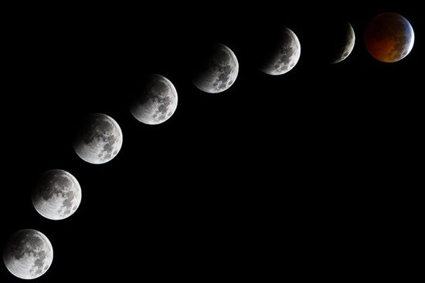
The Moon
Presented by
Southern Maryland Astronomical Society
©2013 Southern Maryland Astronomical Society

Slide 2
Moon Facts
The moon is the only natural satellite of the earth.
The moon is about 25% the size of the earth.
It is in synchronous rotation with the earth.
One rotation of the moon equals the time for the moon to rotate about the earth.
The moon takes 27.3 days to complete one revolution.
It takes 29.5 days to rotate about the earth.
This causes a single side of the moon to face the earth.

Slide 3
Moon Facts
One day on the moon is equal to about two weeks here on Earth. The same is true for its night. Such long days and nights cause the moon to be both very hot and then very cold.
Daytime temperature 225 F.
Nighttime temperature -243 F.
These are surface temperatures as there is no atmosphere so no “air temperature”.

Slide 4
Moon Facts
The Moon is about 4.5 billion years old.
It has no magnetic field, so you cannot use a compass to find your way around.

Slide 5
Moon Phases

Slide 6
Moon Phases
As the moon rotates about the earth it presents different looks to viewers.

Slide 7
Moonrise
The New Moon always rises at sunrise.
The first quarter Moon rises at noon.
The Full Moon rises at sunset.
The last quarter Moon rises at midnight.
Moonrise takes place about 50 minutes later each day than the day before.

Slide 8
Moon Legends
There is a British legend that if Christmas fell on the day of a dark Moon, the following year's harvest would be a bountiful one. Some parts of the British Isles believed that a waxing moon on Christmas meant a good crop the next fall, but a waning moon indicated a bad one would come.
The first time you see a crescent moon for the month, take all your spare coins out of your pocket, and put them in the other pocket. This will ensure good luck for the next month.

Slide 9
Moon Legends
The Strange Case of Dr. Jeckyll and Mr. Hyde, by Robert Louis Stevenson, was inspired by the strange -- and yet very true -- case of Charles Hyde, a London man who committed a series of crimes at the time of the full moon.
Everyone knows that werewolves come out on the full moon.
Dogs and wolves like to howl at the moon.

Slide 10
What’s wrong with this picture?

Slide 11
Full Moon Names
We have all heard of the Blue Moon and Harvest moon.
The Blue Moon is the second full moon of a month. They don’t occur often.
A harvest moon is the full moon that appears nearest to the autumnal equinox.
Each month’s full Moon has a name.
The names come from American Indian and folklore sources.

Slide 12
January
Old Moon
or
Moon After Yule

Slide 13
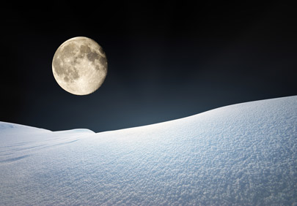
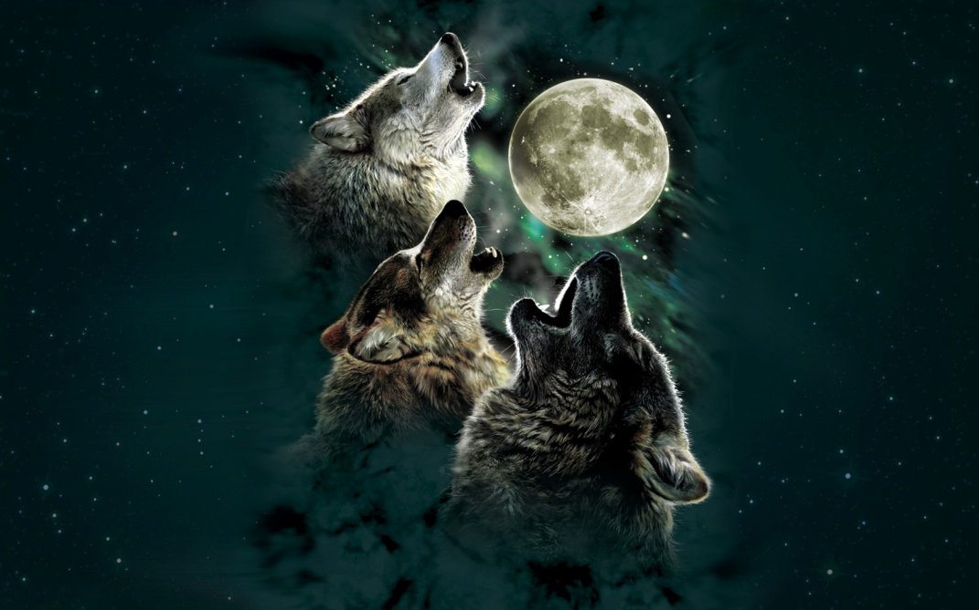
February
Snow Moon
Wolf Moon

Slide 14
March
Crow Moon
Lenten Moon

Slide 15
April
Grass Moon
Egg Moon

Slide 16
May
Planting Moon

Slide 17
June
Rose Moon
Strawberry Moon

Slide 18
July
Thunder Moon

Slide 19
August
Green Corn Moon

Slide 20
September
Harvest Moon
Or
Fruit Moon

Slide 21
October
Hunter’s Moon
Harvest Moon

Slide 22
November
Frosty Moon

Slide 23
December
Moon Before Yule
Long Night Moon

Slide 24
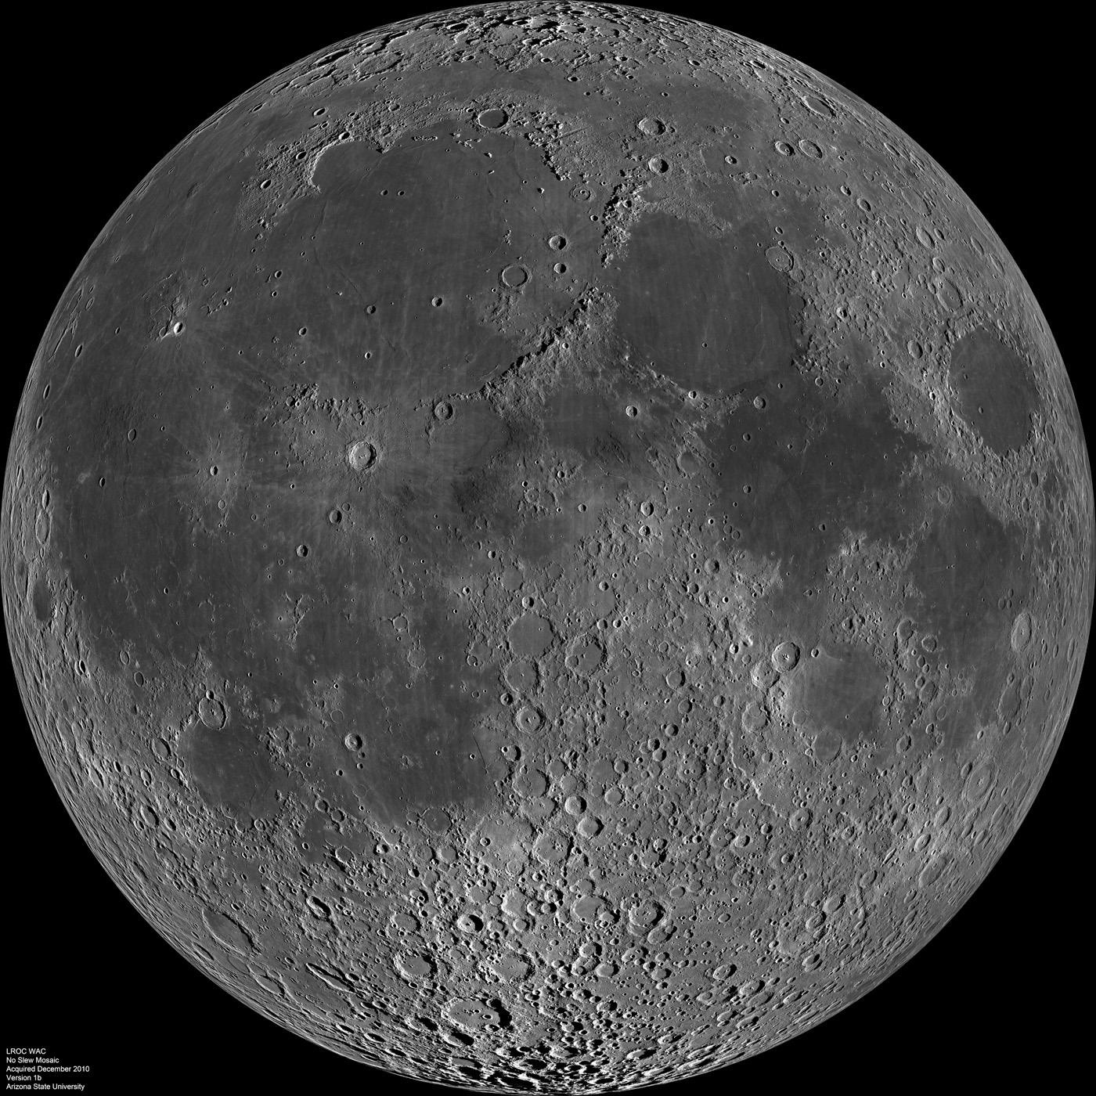
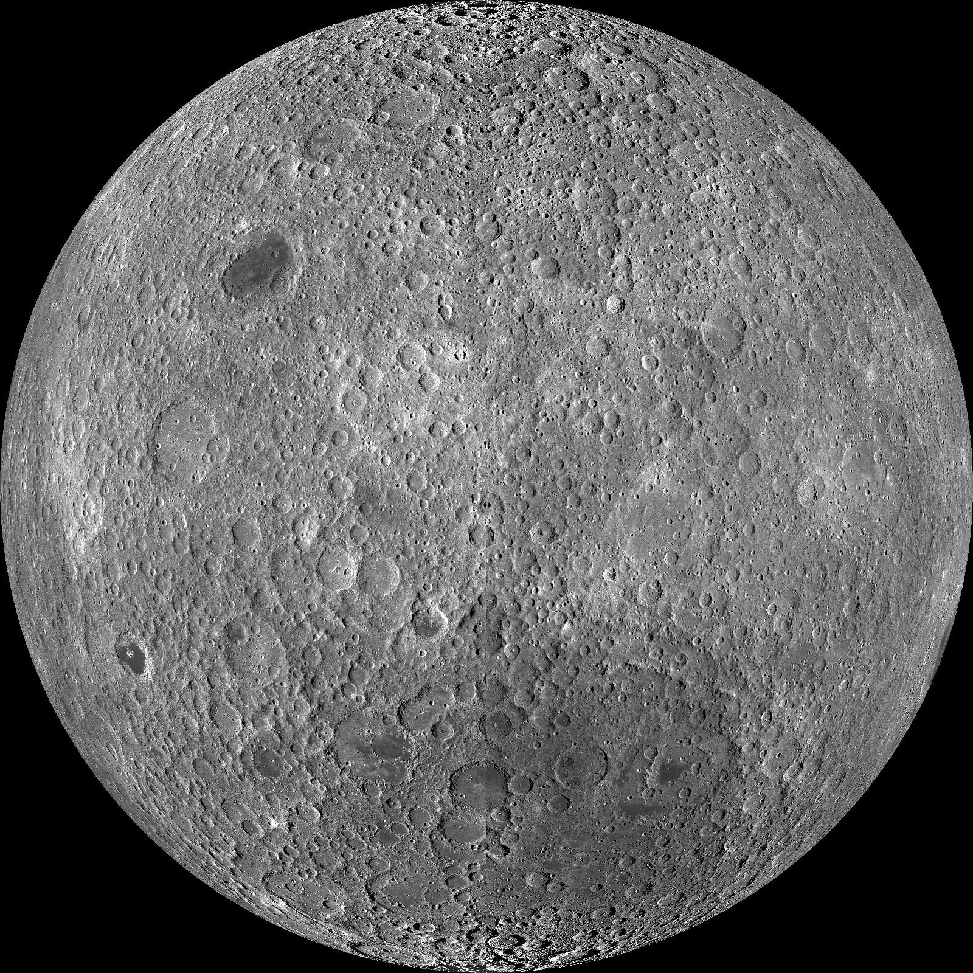
Nearside
Farside

Slide 25
Late Heavy Bombardment
The Late Heavy Bombardment sometimes referred to as the lunar cataclysm, is a hypothetical event around 4.1 to 3.8 billion years ago.
Based on radiometric dating of lunar samples returned by the Apollo program.
One theory has the gas giants migrating outward causing items in the asteroid and Kuiper belts to collide with the Moon, Earth, Mars, Venus and Mercury.

Slide 26
By the Numbers

Slide 27
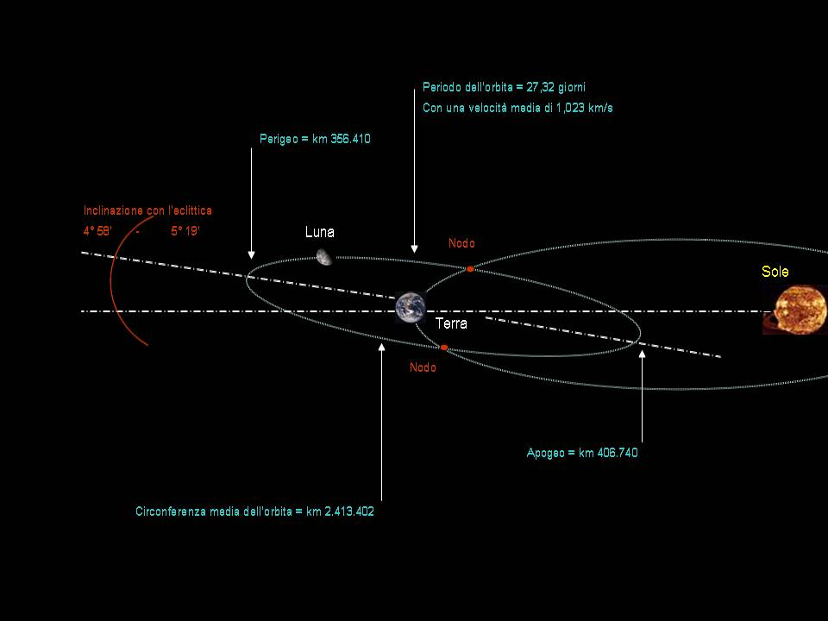

Slide 29
Sun Super Moon

Slide 30
Mariner 10

Slide 31
Messenger 114,000 miles out

Slide 32
Mars Odyssey
2 Million Miles Out

Slide 33
ISS Moon Flyby

Slide 36
Questions?

